Slide 1
Blending Innovation and Regulation:
The New Data Centre Design Recipe
DCW 2025
13th March 2025

Slide 2
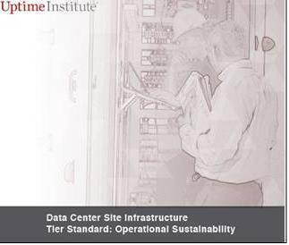

Slide 3
The Uptime Institute developed the Tier rating standard in 1994
The first Data Centre (DC) design standard of the modern era
During this presentation we will try to answer the questions:
30 years after the first design guidance was released:
How have regulations & guidance changed?
Are current regulations & guides fit for purpose?

Slide 4
History

Slide 5
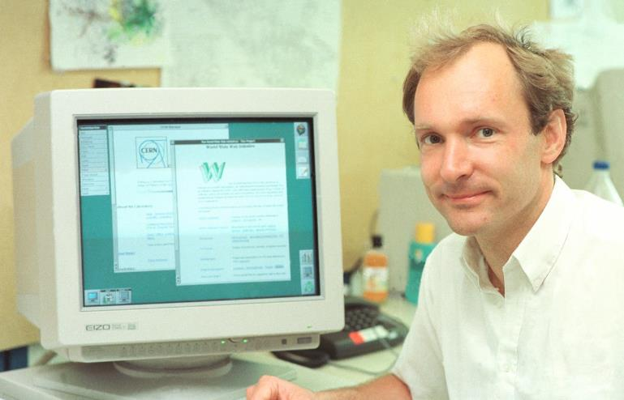
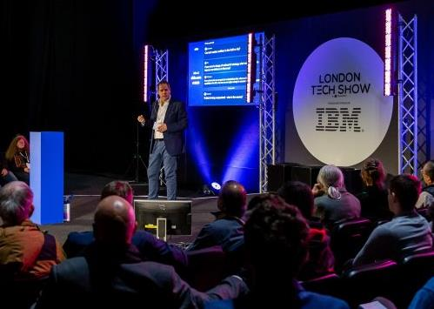
1994
How did it start?
2004
‘the birth of the internet’ - ‘World wide web’ - ‘information superhighway’
2005
2008
2018
2021
2022
2024
2025
2026
2030

Slide 6
1st Decade of internet growth
1994
2004
NFPA 75
Standard for the Fire Protection of Information Technology Equipment - Addresses fire protection requirements for data centres.
2005
2008
Up Time Institute
2018
Telecoms
2021
2022
2024
NFPA
2025
2026
Tier Rating Standard
Gained recognition in 1995
Most DCs were in fact
Telecoms switch rooms
2030
2025
2025

Slide 7
American Influence
1994
Comprehensive planning guidelines
Including clear delineation of component parts of a typical DC facility
2004
2005
2008
2018
ASHRAE
Finance Demand
2021
2022
2024
ANSI/TIA-942
2025
Financial Transactions online leads to a demand for increased DC resilience & capacity
2026
Thermal Guidelines for Data Processing Environments
2030
2025
2025

Slide 8
Pre Financial 2008 Crash
1994
2004
2005
2008
2018
2021
2022
2024
EU Code of Conduct
Trading
Microsoft
‘Copy’ & ‘Mirror’ & ‘HFT’ trading enabled by DCs helps spread the flash crash
Start running servers in tents.
The industry is eager to push the boundaries of efficiency to reduce energy cost.
2025
The first guidance referenced by regulation in the EU.
2026
2030
2025
2025
2025

Slide 9
British Influence
1994
2004
2005
2008
2018
2021
2022
2024
BREEAM DCs
CIBSE KS18
BS EN 50600
RICS
Data Centre Scheme launched (certification started in 2010)
CIBSE’s only real DC guidance manual
The cornerstone of ISO 22237 and still one of the most influential guidance standards
Valuation for Data Centres
2025
2026
2030
2025
2025
2025

Slide 10
International collaboration
1995
2021
2004
2005
2018
2021
2008
2018
2021
NABERS The Rules Energy for Data Centres Version 1.0
2022
2024
2025
ISO 22237 – International version of BS EN 50600
Climate Neutral Data Centre Pact Launched (CNDCP)
2026
2030
2025
2025
2025

Slide 11
EU Gets Serious
1994
2022
2004
2005
2022
2022
2008
2018
2021
Corporate Sustainability Due Diligence Directive
(CSDDD) Adopted
2022
2024
2025
EU Energy Efficiency Directive (EED) REPowerEU plan proposed
Council of the EU adopts is ‘common position’ on the AI Act - DORA
2026
2030
2025
2025
2025

Slide 12
Updates and implementation
1994
2023
2023
2004
2005
2023
2024
2008
2018
2021
LEED v5 Draft issued
German Energy Efficiency Act (EnEfG) all DCs in Germany to achieve 1.2 PUE from July 2026
2022
2024
2025
Energy Efficiency Directive stricter targets for DCs as part of the REPowerEU adoption
Corporate Sustainability Reporting Directive (CSRD) First Year of reporting
2026
2030

Slide 13
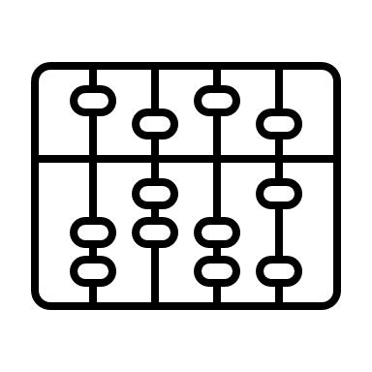
It never rains, it only pours!
1994
2004
BREEAM v6
F-Gas regulations
2005
Draft for comment
EU 2024/573 comes into force
2008
2018
2021
2022
UK CNI Designation
UK Net Zero Building Standard released
2024
2025
Data Centre now considered to be critical infrastructure in the UK
2026
2030
Version 1 due in 2025

Slide 14
What is going on this year!
1994
UK Gov. AI Strategy
2004
1
3
US Policy
‘turbocharge AI adoption across the UK’ – ‘AI Growth Zones announced’
2005
Energy, trade, investment, tariffs. The new administration is shaking up world trade.
2008
2018
2021
2022
EU Relax
CSRD/CSDDD
Australian rules 5*
2024
2
4
2025
Less companies need to report
Federal government wants all DCs to maintain NABERS 5* (PUE 1.4)
2026
2030
2030

Slide 15
All bets are off
1994
I talked to many people while making this presentation.
I asked what might change in 2026?
The majority had no idea and don’t have time to worry about it.
What most people are expecting is:
An increase in reporting (not as much as we thought)
Efficiency requirements means increased capex
Some sites will no longer be technically viable
2004
2005
2008
2018
2021
2022
2024
2025
2026
2030
2030

Slide 16
Net Zero?
1994
By 2030 Progress towards ‘Net Zero’ should be well advanced for Paris Agreement countries.
Companies with ‘Net Zero by 2030’ commitments face a test of resolve
For those who have not…you will still have to deal with:
New standards & regulations: New standards & regulations: UK Net Zero Building Standards, SBTi targets, IFRS reporting, NABERS, MEES, Greenmark, UK building regulations, GRESB Benchmarks.
New reporting requirements in: EU, UK, Singapore, Japan, Australia, California, Iceland, Norway, US (SEC), ISSB, SDS, TNFD & TCDF.
2004
2005
2008
2018
2021
2022
2024
2025
2026
2030

Slide 17
30 years after the first design guidance was released:
How have regulations & guidance changed?
Are current regulations & guides fit for purpose?

Slide 18
How have regulations & guidance changed?
Clearly the number, diversity and technical content has grown exponentially.
The majority of changes have been driven by climate change and H&S risk mitigation.
Little consideration has been given to how projects are procured or how the ICT technology within the buildings effect the building's performance.
Developers:
We building process-driven, business-critical machines with real estate considerations. Not the other way around. Regulations have changed to require more reporting and increased efficiency but fail to address our business: Building ICT Infrastructure.
Designers:
Regulations have been updated but still lag far behind the designs we are delivering; our compliance is measured against client requirements rather than guidance documents or regulations. (EG. 99.999)

Slide 19
Are current regulations & guides fit for purpose?
Developers: No
For projects in Europe we have no idea which standards or regulations are here to stay and which are likely to change in the next few years.
If our competitors decide to take the risk and ignore a regulation, they could have a competitive advantage!
and, Yes
The relaxation of EU regulations announced in Feb 2025 will assist many businesses in our sector.
Guidance and lobbying from the EUDCA, Climate Neutral Data Centre Pact and other trade organisations are helping us navigate the ever-changing political landscape.
In the UK the new Climate Change Agreement incentive scheme could help the sector reduce energy costs from reduced Climate Chance Levy payments from 2026 onwards.

Slide 20
Are current regulations & guides fit for purpose?
Designers: Yes
We have specific efficiency targets, design limits for PUE/WUE/CUE, KPIs and metering requirements.
We can design to these and advise clients on site due diligence and systems design.
The efficiency targets are technically feasible but are marginalising solutions in some regions.
Groups like the ASHRAE (T9.9), UK NZ BS, the ASHRAE DCSIG and CIBSE DCSIG can help our sector grow sustainability
and, No
A 1.2 PUE (annualised) without adequate water is not feasible in many locations!
Regulations do not address Waste heat reuse, Grid connections, Planning requirements etc
Still using outdated procurement & delivery structures borrowed from the construction sector.

Slide 21
International & National v’s Regional & Local?
There are rules and regulations coming from all angles! International, national, regionals and local.
International and national policies broadly support sector growth (economic growth & investment) and local policies react to voter considerations (Environment and community) requiring differing levels of EIA/EMISSIONS/BREEAM/LEED etc.
It is not clear which we should be paying attention to.
Who has the time to check them all?
It is like wading through treacle.
We have too many ingredients.

Slide 22
One size does not fit all.
Early regulations & guides where ‘one size fits all’ reaction to the demands of the prevalent ICT technologies.
These aimed to look after the humans servicing the ICT as much as looking after the ICT itself.
(Human scale, building regulations)
Later regulations looked to standardise the approach to DCs as businesses morphed into multinational conglomerates.
(The birth of the BOD approach)
But the regulators caught up! The second generations of guides and regulations aiming to increase efficiency, reduce energy consumption and carbon usage and increase reporting. National governing bodies driven by the voting public have swung from being pro sustainability to being pro business, aimed to control the growth of the sector.

Slide 23
Then the technology jumped ahead.
The DCs we are building today have little in common to the IT Cupboards we used to call data centres.
Meanwhile, regulators are scrambling to catch up, chasing down the positive potential in the industry opening the door as wide as they dare without inviting the destruction of the environment and power infrastructure.
The gap between national government policies chasing sector growth and local NIMBY concerns means DCs are now, more constrained by hyper local influence.

Slide 24
Conclusion:
The gap between national government policies which is supporting sector growth and local NIMBY concerns means DCs are more constrained by local influence than ever before.
Country by Country, region by region, site by site,
One size does not fit all.
Any neither do most BODs

Slide 25
Shameless Plug:
UK Net Zero Building Standard

Slide 26
ASHRAE UK
DC Special Interest Group

Slide 27
CIBSE
DC Special Interest Group

Slide 28
1. 1995: Uptime Institute's Tier Standard - Introduced to evaluate the reliability and redundancy of data centre infrastructure. 2. 1995: NFPA 75: Standard for the Fire Protection of Information Technology Equipment - Addresses fire protection requirements for data centres. 3. 2004: ASHRAE Thermal Guidelines for Data Processing Environments - Provides environmental parameters for operating data centres. 4. 2005: ANSI/TIA-942: Telecommunications Infrastructure Standard for Data Centers - Comprehensive guidelines for planning and designing data centre telecommunications infrastructure. 5. 2008: EU Code of Conduct for Data Centres (Energy Efficiency) - Voluntary initiative to improve energy efficiency in data centres across Europe. 6. 2009: BREEAM for Data Centres - Specific criteria for assessing the sustainability of data centres. 7. 2011: RICS Valuation of Data Centres, 1st edition - Guidance for valuers to assess the market value or rent for data centre properties. 8. 2012: CIBSE KS18: Data Centres: An Introduction to Concepts & Design - Introduction to the design, operation, and space planning of data centres. 9. 2014: BS EN 50600-2-1:2014 - Detailed guidelines for the construction of data centre facilities and infrastructures. 10. 2018: ISO/IEC TS 22237-1:2018 - General concepts and guidelines for data centre facilities and infrastructures. 11. 2021: IMechE Guidelines - Addressing engineering challenges in critical environments like data centres. 12. 2021: ISO/IEC 22237-1:2021 - Revised guidelines for data centre facilities and infrastructures. 13. 2022: EU Energy Efficiency Directive (EED) - Updated to include stricter energy efficiency targets for data centres. 14. 2023: EU Corporate Sustainability Reporting Directive (CSRD) - Requires data centres to report sustainability indicators, energy, and carbon emissions. 15. 2024: BREEAM (Building Research Establishment Environmental Assessment Method) - Updated to include specific criteria for data centres. 16. 2025: UK Government's AI Strategy - Announced to turbocharge AI adoption across the UK, including the creation of AI Growth Zones to support AI infrastructure.
17. 2025: LEED (Leadership in Energy and Environmental Design) - New version expected to include enhanced guidelines for data centre sustainability. 18. 2026: NABERS (National Australian Built Environment Rating System) - Anticipated update to include data centre-specific energy and water efficiency metrics. 19. 2027: GRESB (Global Real Estate Sustainability Benchmark) - Expected to introduce new benchmarks for data centre sustainability performance. 20. 2028: STBI (Swedish Technical Building Institute) - Planned release of guidelines for sustainable data centre construction and operation. 21. 2029: Greenmark - Singapore's green building rating system expected to include new standards for data centres. 21. 2030: UK Building Regulations - Anticipated updates to include stricter energy efficiency and sustainability requirements for data centres. 23. 2030: MEES (Minimum Energy Efficiency Standards) & EPCs (Energy Performance Certificates) - Expected to introduce new thresholds for data centre energy performance.

